Slide 1


<Name>
<Date>

Slide 2

Outline
Executive Summary
Introduction
Methodology
Results
Conclusion
Appendix

Slide 3
Executive Summary
Summary of methodologies
Summary of all results

Slide 4
Introduction
Project background and context
Problems you want to find answers
we will predict if the Falcon 9 first stage will land successfully

Slide 5

Section 1

Slide 6
Methodology
Executive Summary
Data collection methodology:
Describe how data was collected
Perform data wrangling
Describe how data was processed
Perform exploratory data analysis (EDA) using visualization and SQL
Perform interactive visual analytics using Folium and Plotly Dash
Perform predictive analysis using classification models
How to build, tune, evaluate classification models

Slide 7
Data Collection
Data were collected from two sources.
One was SpaceX API, where there are the Informations about racket features e.g., Payload mass, Launch Site, Reached Orbit, Booster Version
The second one was web scraping of the Wikipedia, the page about launches records. Mainly about launch outcome or booster landing
You need to present your data collection process use key phrases and flowcharts

Slide 8
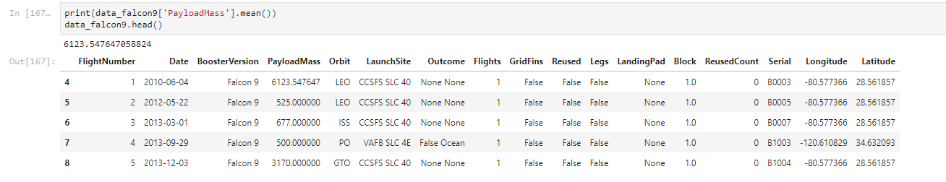
Data Collection – SpaceX API
We aimed at:
Falcon 9 Booster Version and Rockets with single payloads and cores
Dates of the launches to 11/13/2020
Dealing with missing values: Related only to PayloadMass variable, where we replaced it by mean
In the flowchart below we can see the first five rows of the final API dataframe
GitHub notebook is accessible at jupyter-labs-spacex-data-collection-api

Slide 9
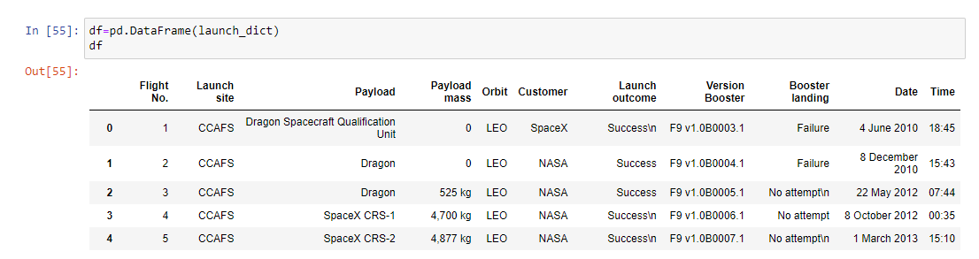
Data Collection - Scraping
We aimed at:
Requesting the Falcon9 Launch Wiki page
Extracting all column/variable names from the HTML table header
Creating the data frame by parsing the launch HTML table from wikipedia.org
In the flowchart below we can see the first five rows of the final webscraping dataframe
GitHub notebook is accessible at jupyter-labs-webscraping

Slide 10
Data Wrangling
Describe how data were processed
Here we aimed to create explanatory/dependent variable from data about landing outcomes: Booster successfully or unsuccessfully landed
To find the best explanatory variable we:
calculated the number of launches on each site
calculated the number and occurrence of each orbit
calculated the number and occurence of mission outcome per orbit type
created a landing outcome label from Outcome column
GitHub URL of completed data wrangling can be found Here

Slide 11
EDA with Data Visualization
We used these charts:
Scatterplots are used in connection to continous variables to visualize relationships among them e. g. Flight Number and Launch Site, Payload and Launch Site and so on
Bar charts are used to visualize relantionships for categorical variables in connection to continuous variables, e. g. success rate and orbit type
Line chart to see trends in time, e. g. success rate per year
Finally we made one hot coding on categorical variables to be read by algorithm for modelling
GitHub URL of completed EDA with data visualization notebook can be found Here

Slide 12
EDA with SQL
Using bullet point format, summarize the SQL queries you performed
In all cases we used SELECT statement to display needed informations from dataset
In queries we used commands in conditions like: WHERE, LIKE, LIMIT, IN
We used subqueries in some queries
We sorted and grouped outputs in queries
Named selected recounted columns in queries by AS command
GitHub URL of completed EDA with SQL notebook can be found Here

Slide 13
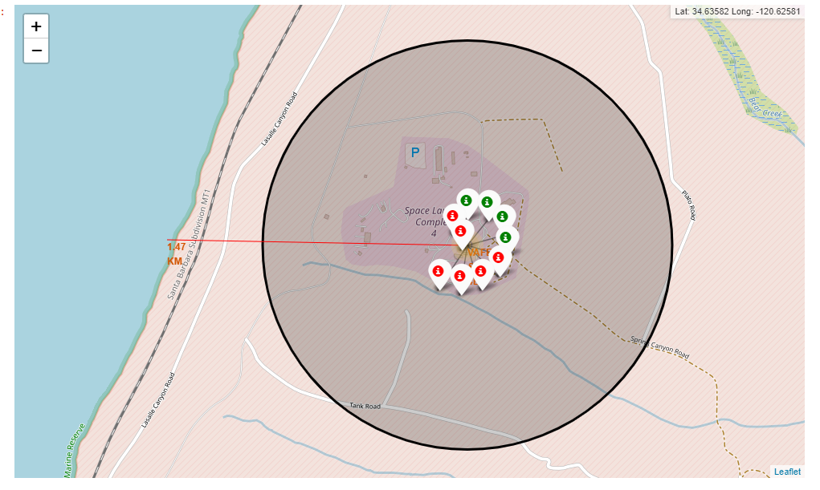
Build an Interactive Map with Folium
We added these objects to the folium map:
circles in the map to see launch sites
markers to differentiate success/failure of each flight
And lines to see distance to the launch sites‘s proximities
These objects are added in the map to find best parameters/positions for success of the launch
GitHub URL of completed EDA with SQL notebook can be found Here

Slide 14
Build a Dashboard with Plotly Dash
We have added in the Dashboard to perform interactive visual analytics on SpaceX launch data in real-time:
A Launch Site Drop-down Input Component
Callback function to render success-pie-chart based on selected site dropdown
Range Slider to Select Payload
Callback function to render the success-payload-scatter-chart scatter plot
The plots are added to the dashboard for finding visual patterns of success of the launch on the basis of Payload Mass, Booster Version and Launch Site.
In the addittion the interactivity enables the users faster and more effectively find these patterns of the success/failure of the launch
GitHub URL of completed Plotly Dash lab can be found Here

Slide 15
Predictive Analysis (Classification)
In the predictive analysis we used logistic regression, support vector machine, decision tree classifier and k nearest neighbors algorithms.
In the preprocessing part we have used preprocessing.StandardScaler() to normalize data and splitted data to the training and teste dataset
For improvement every algorithm we have used GridSearchCV, which enables to test more parameters and automatically find best ones
For evaluation we used confusion matrix and indicators like accuracy, precision, recall and f1-score
GitHub URL of completed predictive analysis lab can be found Here
Normalizing data
Splitting data to the train and test part
Model development
Evaluation of the model

Slide 16
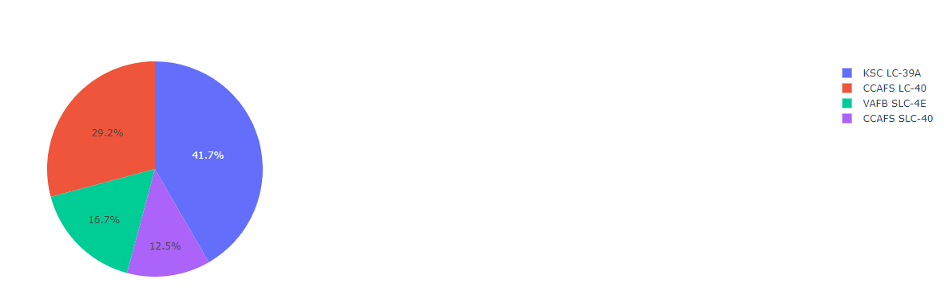
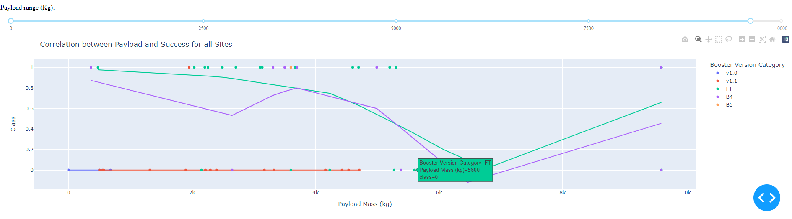
Results
Interactive analytics demo in screenshots
Exploratory data analysis results
We can see that success of the flight depends on the Flight number, Payload Mass, Launch Site, Orbit and Year
Predictive analysis results
All models were able to predict 100 % of successful landing: precision rate 1
The ratio for all positively predicted labels was worse. Recall was 0.5 in three from four models. The only one Decision tree classifier make it better to 0.67.
The best model is Decision tree classifier

Slide 17

Section 2

Slide 18
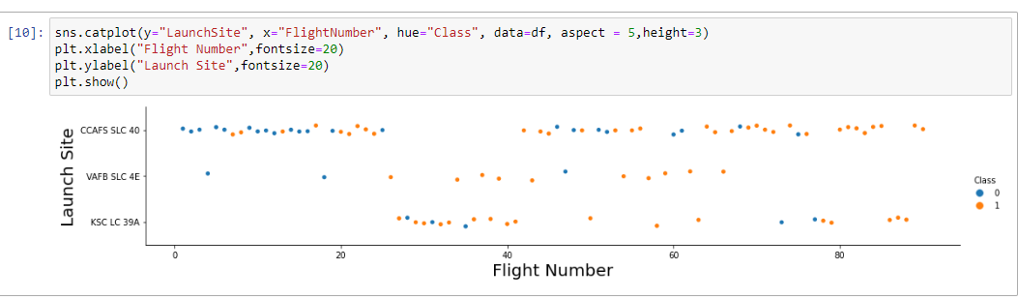
Flight Number vs. Launch Site
Success of the flight depends on the Flight Number and Launch Site
The Flight number is related to the Launch Site

Slide 19
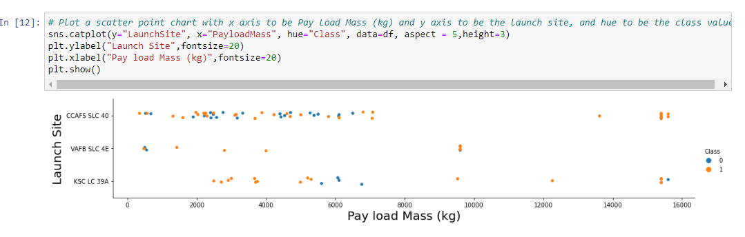
Payload vs. Launch Site
Success of the flight depends on the Pay Load Mass and Launch Site
The Pay Load Mass is related to the Launch Site

Slide 20
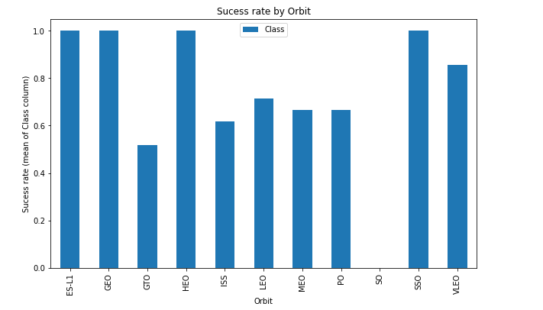
Success Rate vs. Orbit Type
Orbit type influences the Success Rate. ES-L1, GEO, HEO, SSO are much more higher than other types

Slide 21
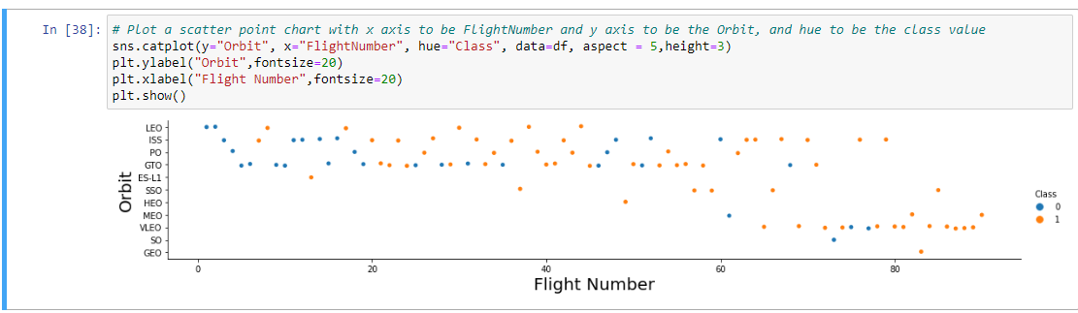
Flight Number vs. Orbit Type
We can see relantionships among the Flight Number and Orbit types. E.g.:
In the LEO orbit the Success appears related to the number of flights
On the other hand, there seems to be no relationship between flight number when in GTO orbit.

Slide 22
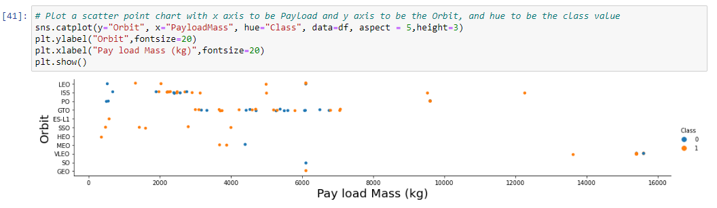
Payload vs. Orbit Type
We can see that there is a relationships between Pay load Mass and Orbit type
With heavy payloads the successful landing or positive landing rate are more for Polar,LEO and ISS

Slide 23
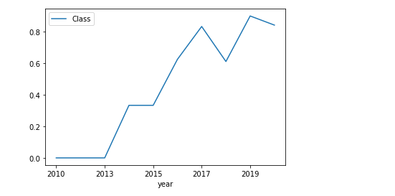
Launch Success Yearly Trend
We can observe that the success rate since 2013 kept increasing till 2020

Slide 24
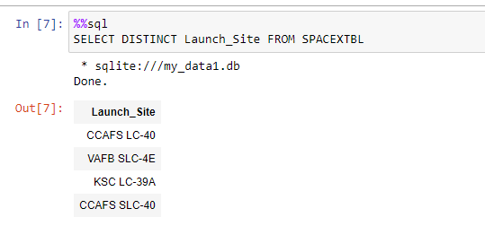
All Launch Site Names
We have four unique launch sites:
CCAFS LC-40
VAFB SLC-4E
KSC LC-39A
CCAFS SLC-40
In the sql query we can see DISTINCT command which prints unique name from Laun_Site column in the dtb

Slide 25
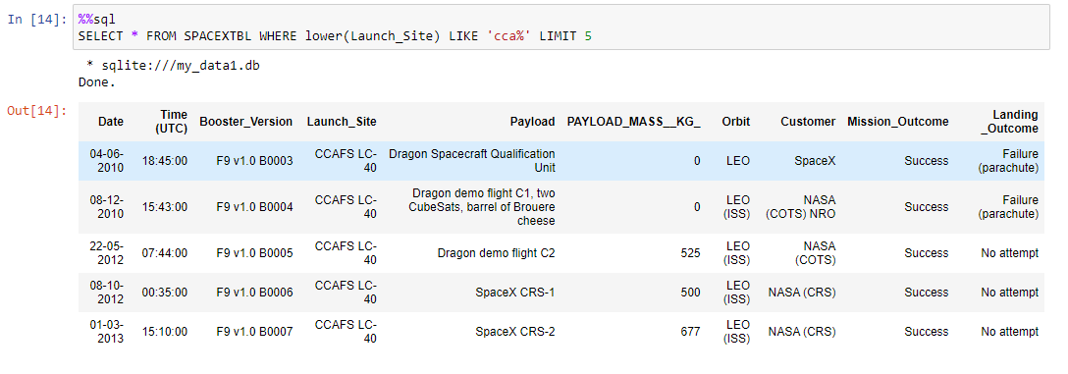
Launch Site Names Begin with 'CCA'
In the query above we have found 5 records in the Launch_Site beginning with ‚CCA‘
The result is the only one Launch Site: CCAFS LC-40

Slide 26
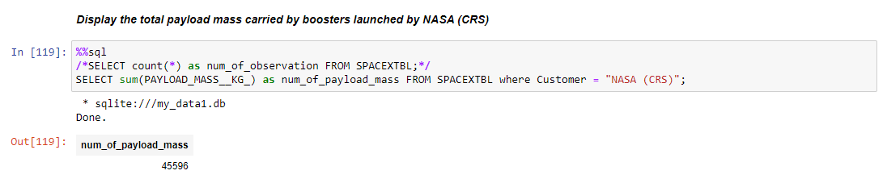
Total Payload Mass
In the query above we have found that total payload carried by boosters from NASA is 45 596 Kg
In the query we searched the value by in-built function sum() and condition where

Slide 27
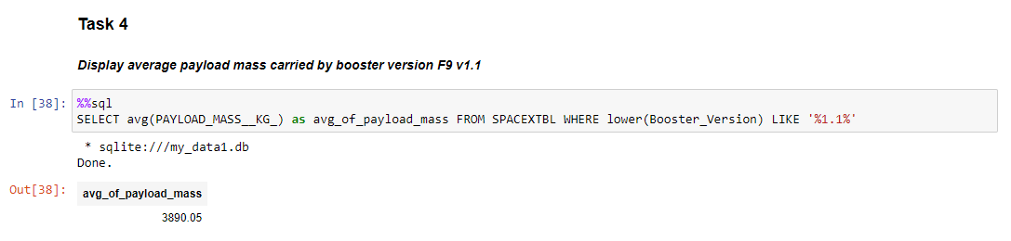
Average Payload Mass by F9 v1.1
In the query above we have found that the average payload mass carried by booster version F9 v1.1 is 3 890.05 Kg
In the query we searched the value by in-built function avg() and condition where statement with connection LIKE

Slide 28
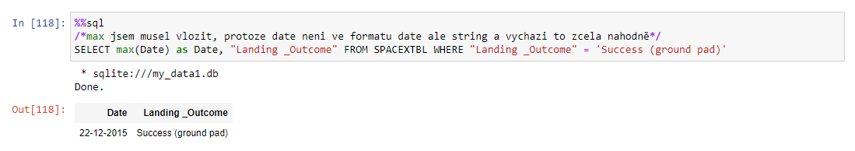
First Successful Ground Landing Date
In the query above we have found that the date of the first successful landing outcome on ground pad is 22. 12. 2015

Slide 29
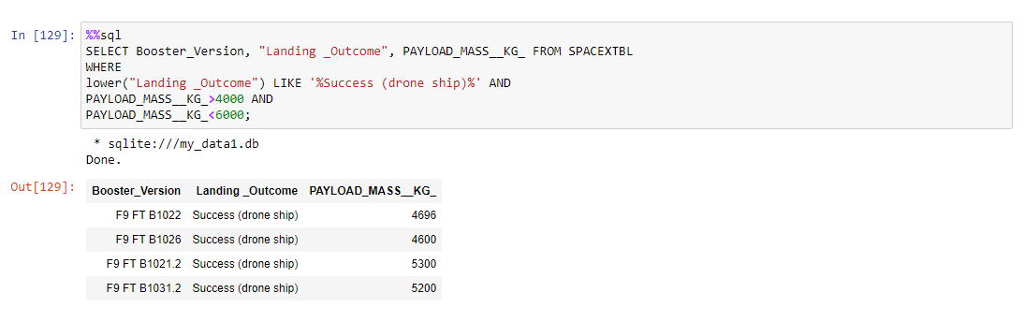
Successful Drone Ship Landing with Payload between 4000 and 6000
In the query above we have listed the names of boosters which have successfully landed on drone ship and had payload mass greater than 4000 but less than 6000
The resulted Boster Versions:
F9 FT B1022
F9 FT B1026
F9 FT B1021.2
F9 FT B1031.2

Slide 30
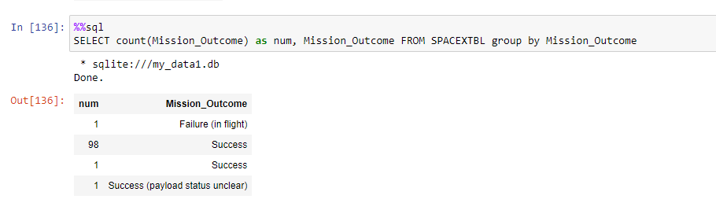
Total Number of Successful and Failure Mission Outcomes
In the query above we have listed the count of the Mission Outcome
In the result we have 100 successful Mission Outcomes and 1 Failure Outcome

Slide 31
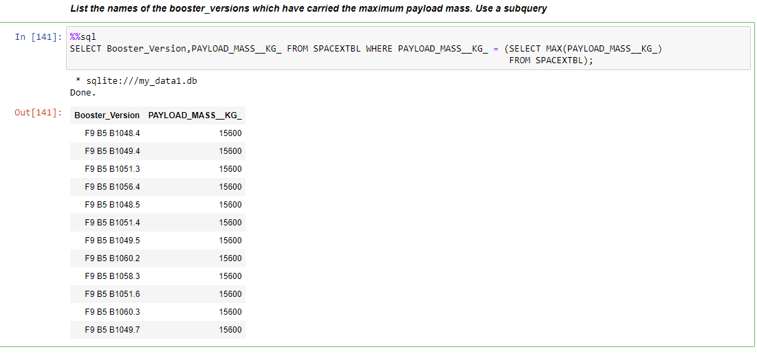
Boosters Carried Maximum Payload
In the query above we have listed the names of the booster version. We have 12 booster versions
The Booster Versions are:
F9 B5 B1048.4, F9 B5 B1049.4, F9 B5 B1051.3, F9 B5 B1056.4, F9 B5 B1048.5, F9 B5 B1051.4, F9 B5 B1049.5, F9 B5 B1060.2, F9 B5 B1058.3, F9 B5 B1051.6, F9 B5 B1060.3, F9 B5 B1049.7

Slide 32
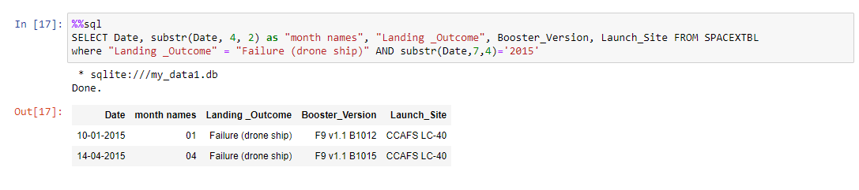
2015 Launch Records
In the query above we have listed the failed landing_outcomes in drone ship, their booster versions, and launch site names for in year 2015
The Booster versions of the failed landing_outcomes are F9 v 1.1 B1012 and F9 v 1.1 B1015 and Launch site CCAFS LC-40

Slide 33
Rank Landing Outcomes Between 2010-06-04 and 2017-03-20
Rank the count of landing outcomes (such as Failure (drone ship) or Success (ground pad)) between the date 2010-06-04 and 2017-03-20, in descending order
Present your query result with a short explanation here

Slide 34

Section 3

Slide 35
<Folium Map Screenshot 1>
Replace <Folium map screenshot 1> title with an appropriate title
Explore the generated folium map and make a proper screenshot to include all launch sites’ location markers on a global map
Explain the important elements and findings on the screenshot

Slide 36
<Folium Map Screenshot 2>
Replace <Folium map screenshot 2> title with an appropriate title
Explore the folium map and make a proper screenshot to show the color-labeled launch outcomes on the map
Explain the important elements and findings on the screenshot

Slide 37
<Folium Map Screenshot 3>
Replace <Folium map screenshot 3> title with an appropriate title
Explore the generated folium map and show the screenshot of a selected launch site to its proximities such as railway, highway, coastline, with distance calculated and displayed
Explain the important elements and findings on the screenshot

Slide 38

Section 4

Slide 39
<Dashboard Screenshot 1>
Replace <Dashboard screenshot 1> title with an appropriate title
Show the screenshot of launch success count for all sites, in a piechart
Explain the important elements and findings on the screenshot

Slide 40
<Dashboard Screenshot 2>
Replace <Dashboard screenshot 2> title with an appropriate title
Show the screenshot of the piechart for the launch site with highest launch success ratio
Explain the important elements and findings on the screenshot

Slide 41
<Dashboard Screenshot 3>
Replace <Dashboard screenshot 3> title with an appropriate title
Show screenshots of Payload vs. Launch Outcome scatter plot for all sites, with different payload selected in the range slider
Explain the important elements and findings on the screenshot, such as which payload range or booster version have the largest success rate, etc.

Slide 42

Section 5

Slide 43
Classification Accuracy
Visualize the built model accuracy for all built classification models, in a bar chart
Find which model has the highest classification accuracy

Slide 44
Confusion Matrix
Show the confusion matrix of the best performing model with an explanation

Slide 45
Conclusions
Point 1
Point 2
Point 3
Point 4
…

Slide 46
Appendix
Include any relevant assets like Python code snippets, SQL queries, charts, Notebook outputs, or data sets that you may have created during this project

Slide 47


